Slide 1





Modelling the SEQ koala distribution under current and future climate scenarios
https://github.com/patch105/ICCB_koala_sdm
Charlotte Patterson, QUT
Scott Forrest, QUT, CSIRO
Hello! Tell us a bit about yourselves
Mentimeter: 6816 7308

Slide 2

Acknowledgement of Traditional Owners
QUT – Turrbal and Yugara
Lands on which data were collected

Slide 3




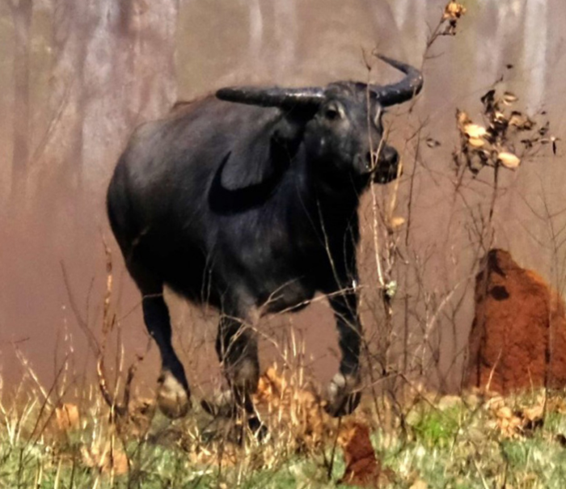
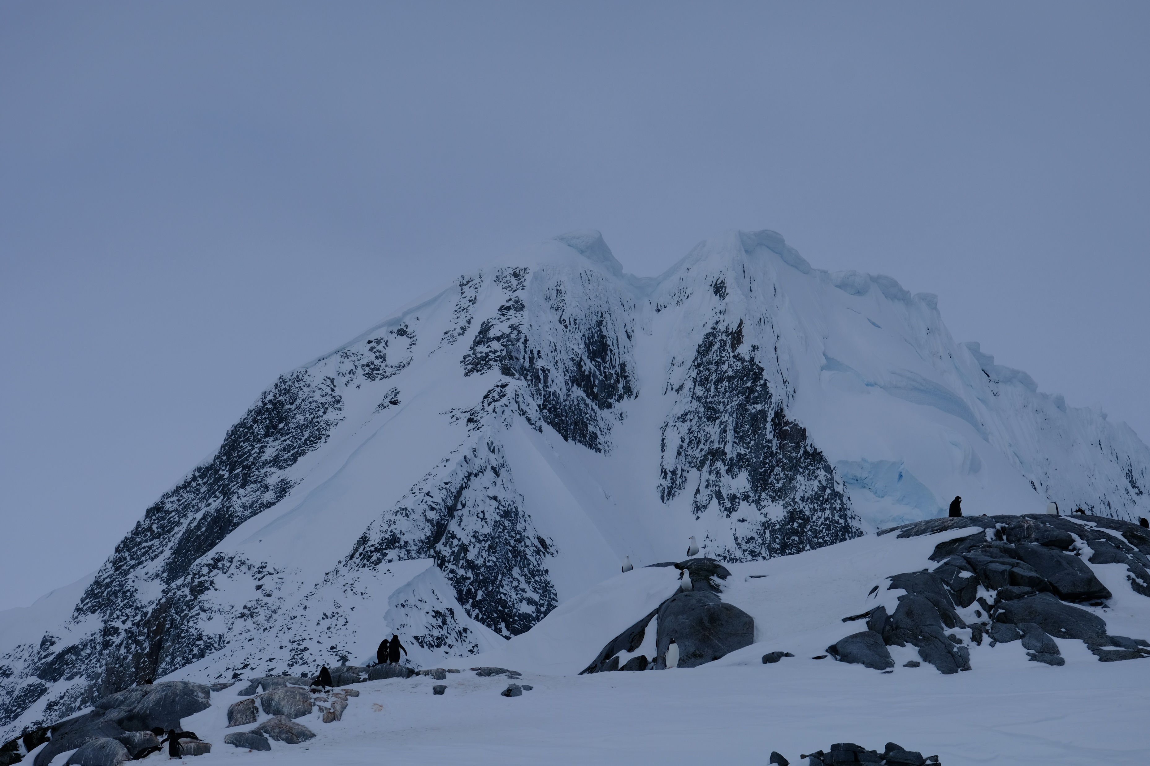
Who are we?

Slide 4
Who are you?

Slide 5

Open-source geospatial tools for conservation under climate change - A Koala case study
Session 1 | Session 2 | Session 3 | Session 4 | Session 5
Intro to geospatial data and tools | Downscaled climate projections | Koala SDMs | Spatial conservation planning | Making maps with QGIS
Jason Flower, Mitch Rudge, Catherine Kim, EcoCommons team | Ralph Trancoso, Sarah Chapman, Rohan Eccles | Charlotte Patterson, Scott Forrest | Brooke Williams, Caitie Kuemple | Emma Hain, Nyall Dawson, Jason Flower

Slide 6
How will this workshop run?
Workshop outline
Intro to SDMs
How to access the data/environmental layers
Climate projections
(Some) Koala ecology
Coded example (interspersed throughout)
Downloading data (koala records/environmental layers)
Environmental variable selection
Background sampling
Modelling
Prediction
Validation

Slide 7


What are we hoping you’ll get out of it?
Overview of SDMs
When they might be useful
Some steps to prepare data and environmental layers
Brief overview of methods, model fitting, prediction and validation
Insight into some key considerations when developing models based on our experience and best-practice
Resources to continue the journey
Flag spots where careful thought is needed for your SDM application
Highlight key messages

Slide 8
Take home message
Modelling is often more art than science. There are many ways to model species, none of them the ‘right way’. Some can, however, be more appropriate for a study question or species.
We make many decisions along the way and need to be transparent and clear about these decisions.
We also need to spend time understanding and communicating the effect of our decisions.

Slide 9
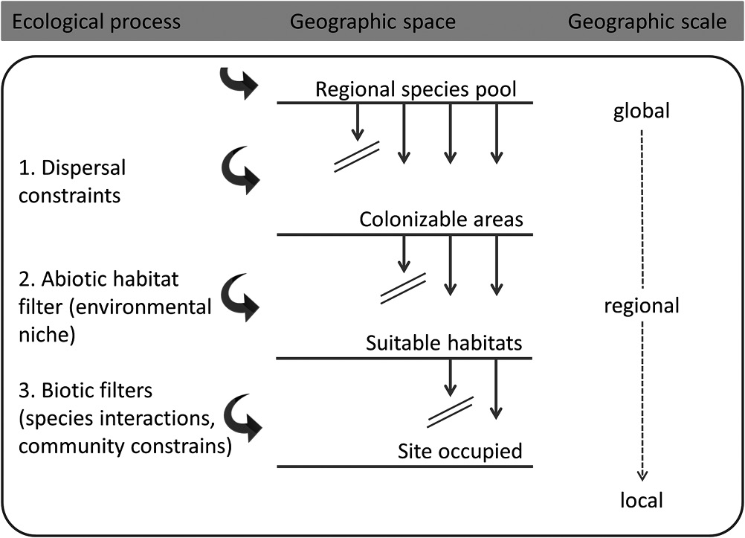
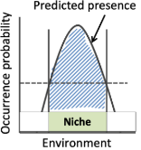
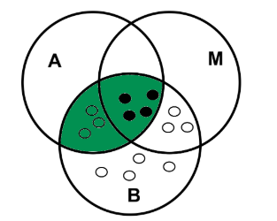
The SDM question: Where are species and why are they distributed as they are?
Ecological Niche Models; Habitat Suitability Models; Climate Envelope Models
Guisan et al. (2017)
Notes:
A is abiotic conditions (fundamental niche); B is biotic interactions A+B = realised niche; movement added in = the occupied niche

Slide 10
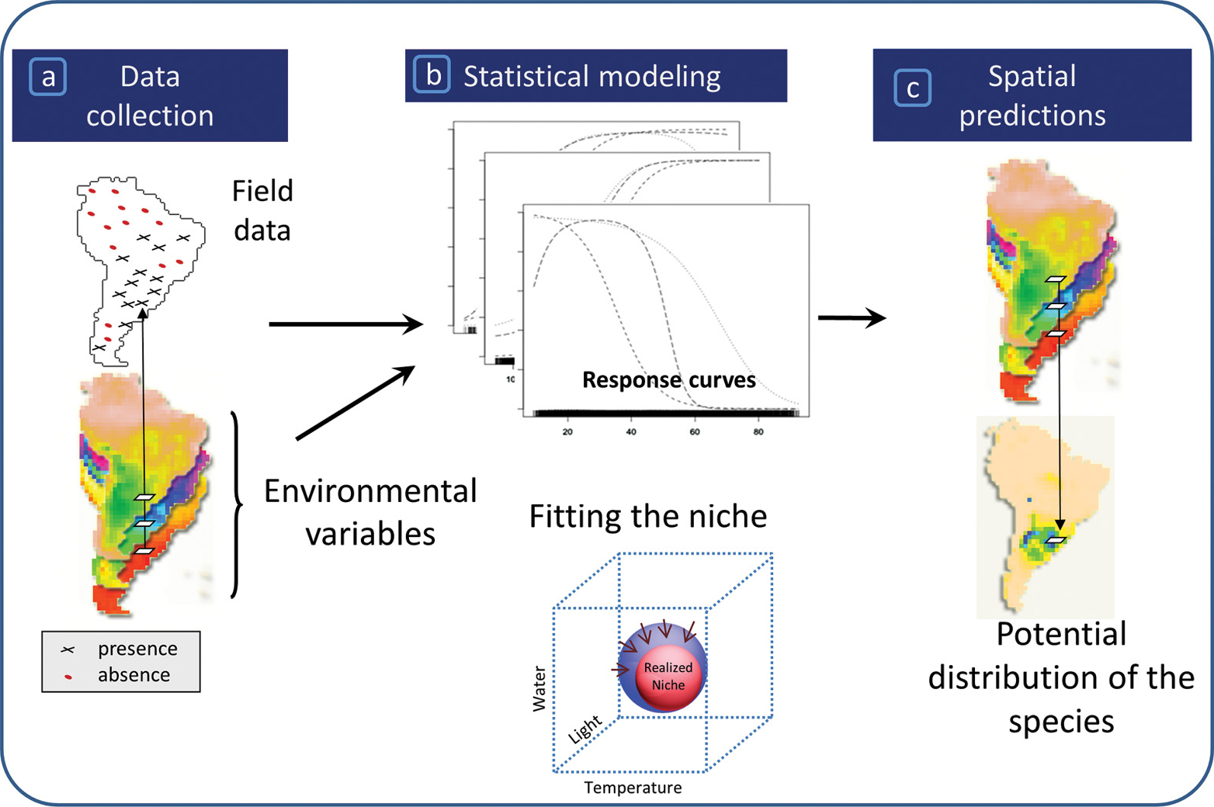
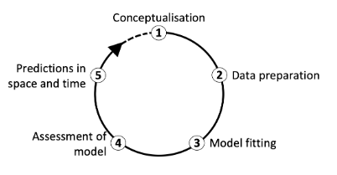
The SDM question: Where are species and why are they distributed as they are?
Zurrell et al. (2020)
Guisan et al. (2017)

Slide 11
So, you think you want to make an SDM…?
Perhaps you want to:
Predict the distribution of a threatened species (e.g., for surveys)
Plan where to put a protected area
Assess the risk of a new invasive species
Understand better what drives the dynamics of a study species
Notes:
Common reasons to want to model.

Slide 12

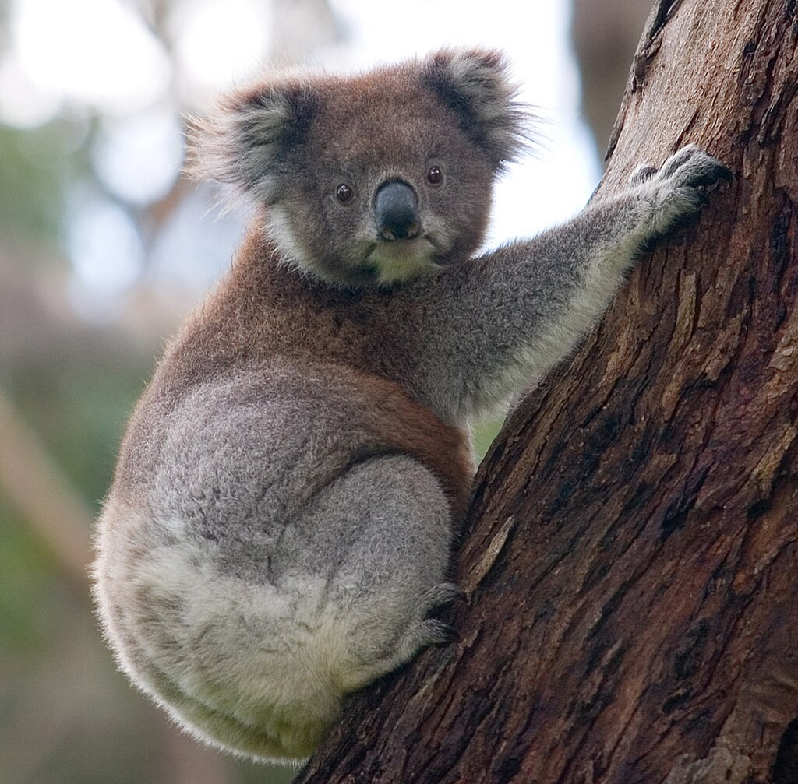
Koala (Phascolarctos cinereus)
The word "koala" comes from the Dharug gula, meaning 'no water’
Phaskolos = pouch, arktos = bear (Greek)
Cinereus = ash coloured (Latin)
Photo by DAVID ILIFF. License: https://creativecommons.org/licenses/by-sa/3.0/

Slide 13
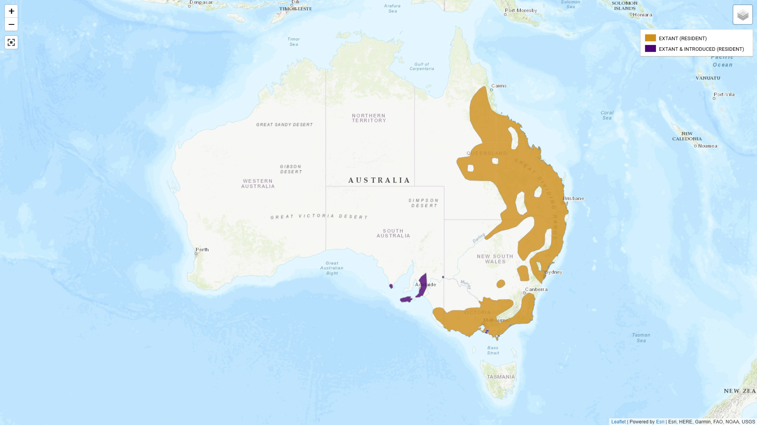

Slide 14
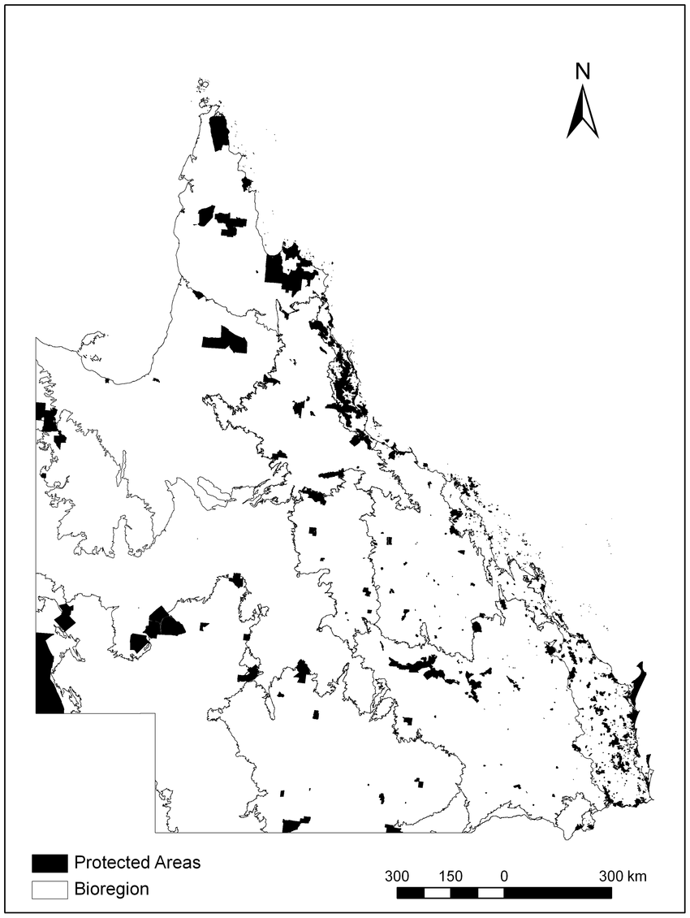
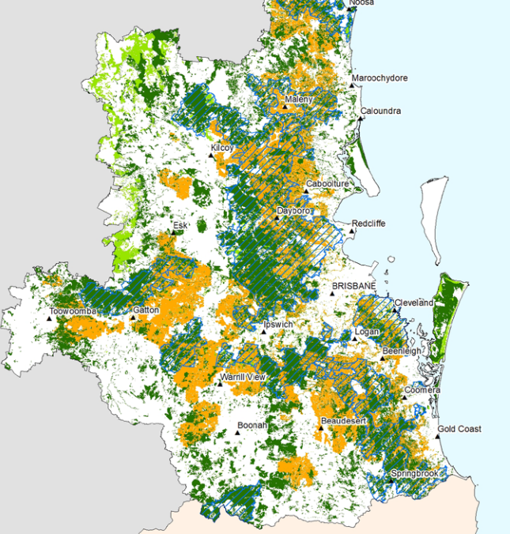
Case Study: Protecting future koala habitat in South-East Queensland
South-East Queensland Koala Conservation Strategy, Qld Govt.
Notes:
Where are the suitable habitats for koalas – where will they be in the future – how do we protect them?

Slide 15
Conceptualisation: Some questions to ask yourself
What is the aim of my model?
Explanation
Mapping
Transfer (spatial and/or temporal)
Araújo et al. (2019). Standards for distribution models in biodiversity assessments. Science advances.

Slide 16
Conceptualisation: Some questions to ask yourself
2. What are my model outputs going to be used for?
Testing hypotheses about a species’ ecology
Spatial prioritisation for protection
Choosing where to survey
Clearly defining your model’s purpose guides your workflow
Guillera‐Arroita et al. (2015). Is my species distribution model fit for purpose? Matching data and models to applications. Global ecology and biogeography.
Notes:
Down a scale of don’t need to be that accurate to need to be really accurate.

Slide 17
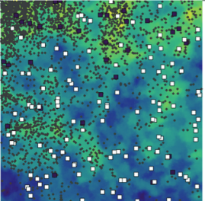
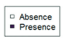
Data for modelling a species distribution
Presence-only
Occurrence/incidental records
Citizen science databases
Presence-absence
Systematic surveys
Atlases
Your data limit what is possible with SDMs. Prioritise quality over quantity.
Notes:
Gold standard is PA but mostly we don’t have PA. Always try to get some. This usually drives the type of model that you can do.

Slide 18
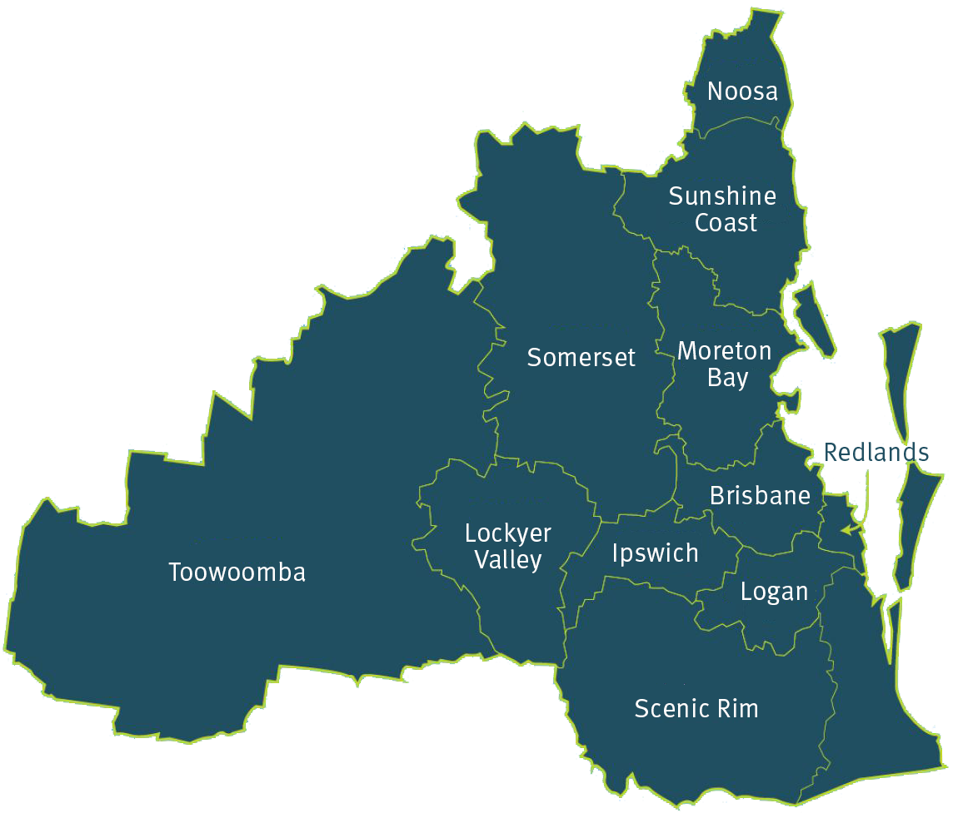
Study region – South East Queensland
Notes:
Selecting a study domain – often should be determined by biology. But can instead be pragmatic

Slide 19
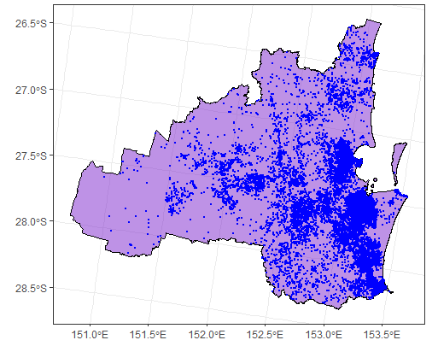




Koala data from the ALA
https://galah.ala.org.au/R/articles/quick_start_guide.html

Slide 20
Background selection
Many ‘presence-only’ approaches rely on the selection of background or ‘pseudo-absence’ points
These points are contrasted against environmental conditions where your species was found
Background selection is a critical step in presence-only SDMs. Choices reflect your understanding of your study species.
Notes:
Gold standard is PA but mostly we don’t have PA. Always try to get some. This usually drives the type of model that you can do.

Slide 21
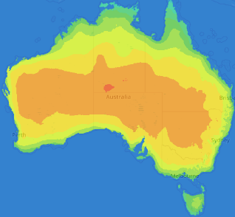
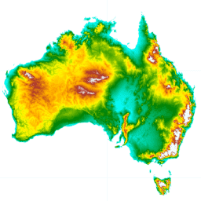
Environmental layers
Raster data representing covariates that can be used to describe a species’ niche.
Common examples are:
‘Bioclim’ variables related to temperature and precipitation
Topographic variables like elevation
Satellite-derived measures of vegetation
Notes:
Key consideration here includes: how relevant are they for defining a species’ niche? What’s available? At what resolution?

Slide 22
Koala (Phascolarctos cinereus)
Found in open forest and woodland
Dependent on specific feeding trees*
~ 30 species of Eucalyptus
Sensitive to land-use change
*a spatial layer of these trees can be used as a mask
Photo by DAVID ILIFF. License: https://creativecommons.org/licenses/by-sa/3.0/

Slide 23
Environmental covariate selection
Option 1. Expert consultation or selection based on species knowledge
Option 2. Correlation & multicollinearity checks
Option 3. Model selection

Slide 24
BIOCLIM Layers
BIO1 = Annual Mean Temperature
BIO2 = Mean Diurnal Range (Mean of monthly (max temp - min temp))
BIO3 = Isothermality (BIO2/BIO7) (×100)
BIO4 = Temperature Seasonality (standard deviation ×100)
BIO5 = Max Temperature of Warmest Month
BIO6 = Min Temperature of Coldest Month
BIO7 = Temperature Annual Range (BIO5-BIO6)
BIO8 = Mean Temperature of Wettest Quarter
BIO9 = Mean Temperature of Driest Quarter
BIO10 = Mean Temperature of Warmest Quarter
BIO11 = Mean Temperature of Coldest Quarter
BIO12 = Annual Precipitation
BIO13 = Precipitation of Wettest Month
BIO14 = Precipitation of Driest Month
BIO15 = Precipitation Seasonality (Coefficient of Variation)
BIO16 = Precipitation of Wettest Quarter
BIO17 = Precipitation of Driest Quarter
BIO18 = Precipitation of Warmest Quarter
BIO19 = Precipitation of Coldest Quarter

Slide 25
Conceptualisation & Data Preparation Resources
Guillera‐Arroita et al. (2015). Is my species distribution model fit for purpose? Matching data and models to applications. Global ecology and biogeography.
Guisan et al. (2017). Habitat suitability and distribution models: with applications in R. Cambridge University Press.
Araújo et al. (2019). Standards for distribution models in biodiversity assessments. Science advances.
Zurell et al. (2020). A standard protocol for reporting species distribution models. Ecography.

Slide 26
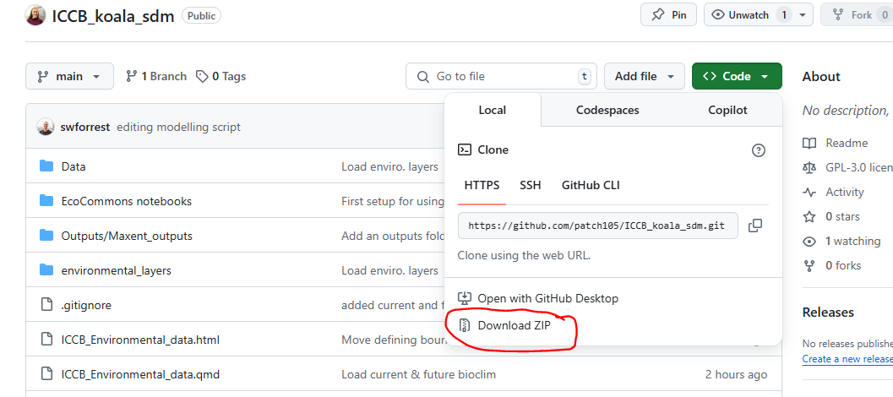
Have a go: Data preparation
https://github.com/patch105/ICCB_koala_sdm

Slide 27
Have a go: Data preparation
https://github.com/patch105/ICCB_koala_sdm
ICCB_koala_sdm.Rproj
ICCB_Environmental_data.qmd
ICCB_Species_data.qmd

Slide 28
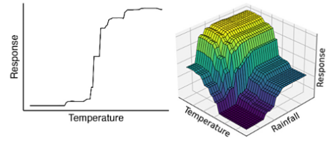
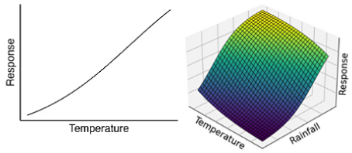
Models and algorithms
Models differ in their flexibility and interpretability
Spectrum from linear to highly non-linear
Different strengths depending on model aim
Generalised Linear Model (GLM)
Generalised Additive Model (GAM)
Random Forest (RF)
Maximum entropy modelling (Maxent)
Deep learning approaches
Convolutional neural networks

Slide 29
Generalised Linear Model (GLM)
Regression
Can fit
Linear: x₁ + x₂ + … + x_{n}
Quadratic: x₁ + x₁² + x₂ + … + x_{n}
Higher order polynomial terms: x₁ + x₁² + x₁³ + x₂ + … + x_{n}
Interactions between covariates: x₁ + x₂ + x₁*x₂ + … + x_{n}

Slide 30
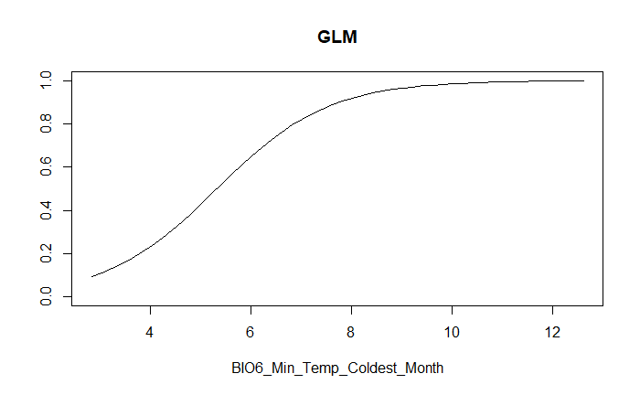
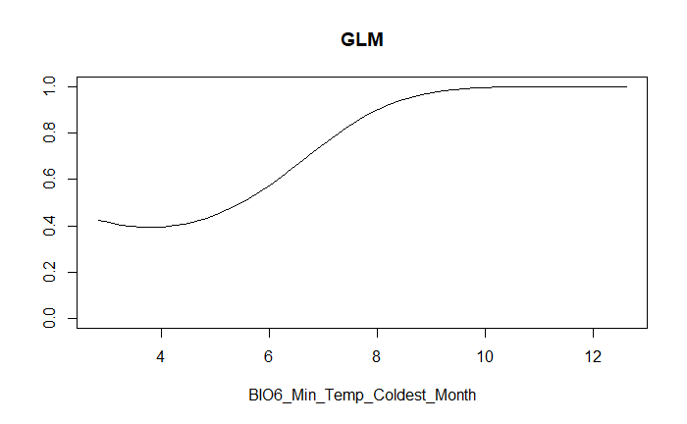
Partial response plots (response curves)
Linear term
Linear + quadratic term

Slide 31
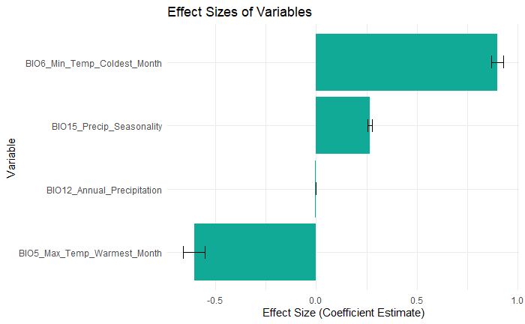
Effect sizes

Slide 32
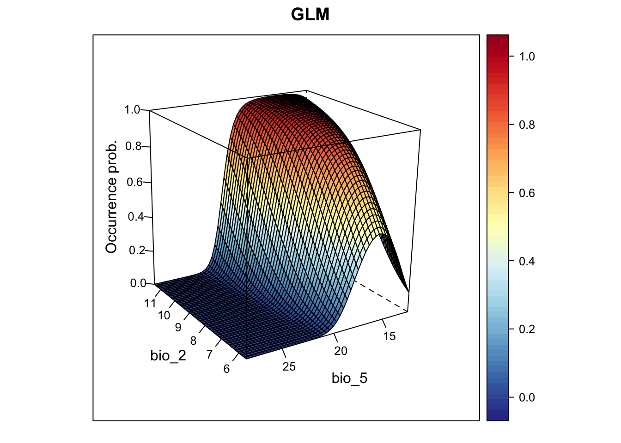
Interactions between covariates
from: https://damariszurell.github.io/SDM-Intro/

Slide 33
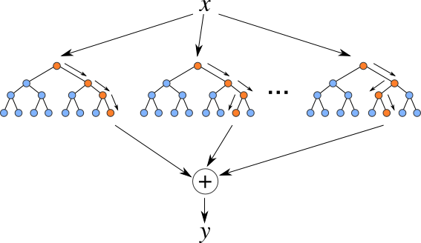
Random Forest (RF)
Classification (binary) or regression
Ensemble of many decision trees (hence ‘forest’)
https://levelup.gitconnected.com/random-forest-regression-209c0f354c84

Slide 34
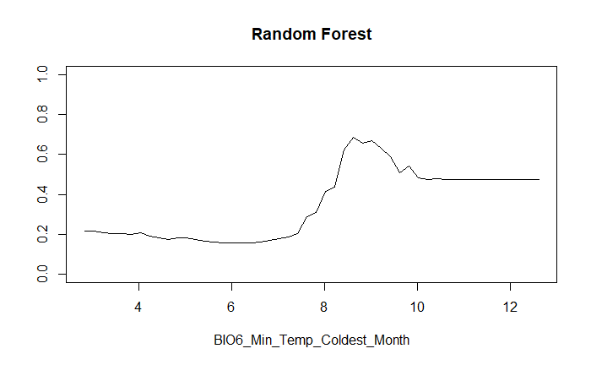
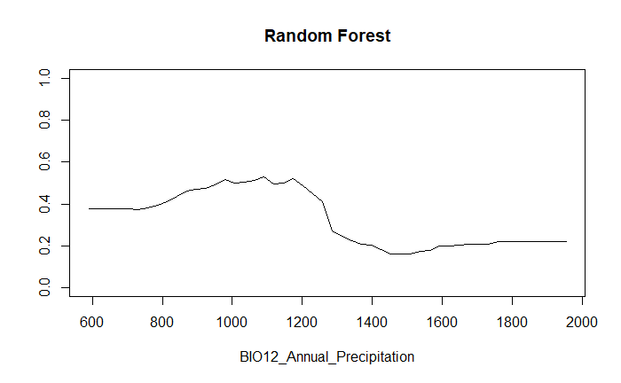
Partial response plots

Slide 35
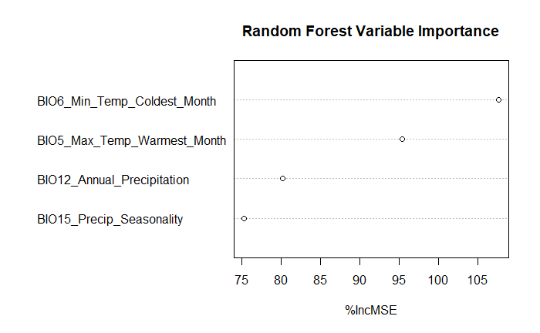
Variable Importance
%IncMSE = change in mean squared error when the variable is permuted (shuffled)
Essentially, how much does this variable affect the predictions?

Slide 36
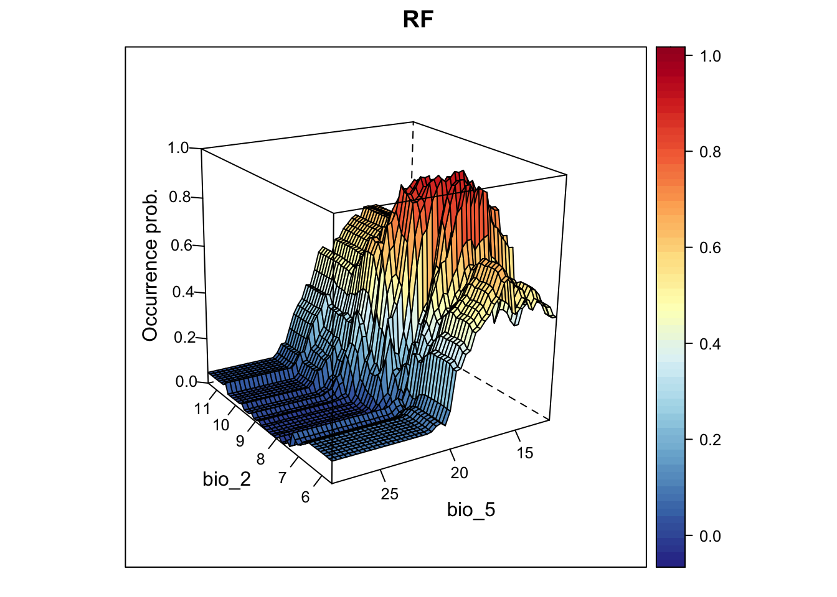
Interactions between covariates
from: https://damariszurell.github.io/SDM-Intro/

Slide 37
Have a go: Data preparation
https://github.com/patch105/ICCB_koala_sdm
ICCB_Modelling_and_validation.qmd

Slide 38
Generating predictions

Slide 39
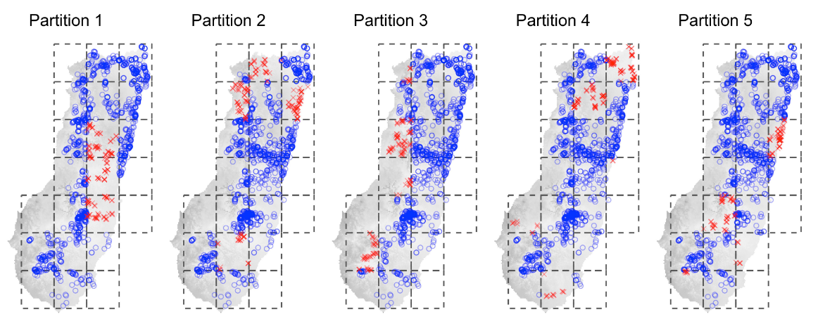
Validating SDMs
Cross-validation (CV)
Hold out a subset of the data to test the model’s predictions against
Spatial block CV
Truly independent presence-absence data is the gold standard
Valavi et al. (2023)

Slide 40
Validating SDMs – Evaluation metrics
‘Threshold-dependent’ or ‘Threshold-independent’
Calibration (e.g., Boyce Index)
Discrimination (e.g., AUC ROC)
Multiple metrics can describe different aspects of model performance – some more or less relevant to your study
Valavi et al. (2023)
Notes:
Calibration = model correctly predict conditional probability of presence
Discrimination = model can discriminate between occupied and unoccupied sites

Slide 41
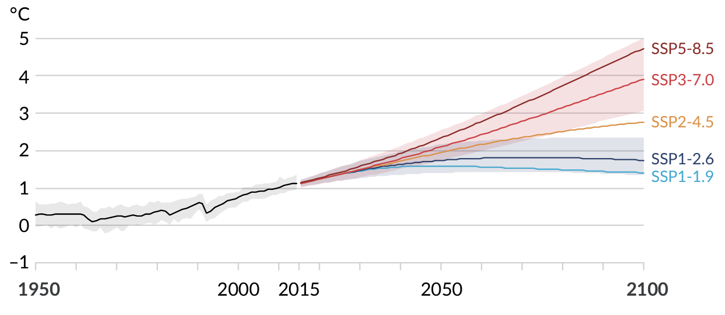
Climate projections
Current
2050
2070
2090
Global surface temperature change relative to 1850-1900. Projected global average surface temperature change in each of the five SSP scenarios. Source: IPCC

Slide 42
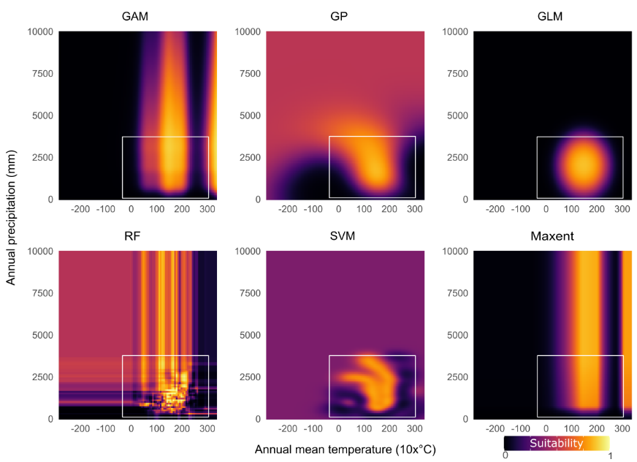
Predicting into the unknown
Velazco et al. (2023)

Slide 43
Take home message
Modelling is often more art than science. There are many ways to model species, none of them the ‘right way’. Some can, however, be more appropriate for a study question or species.
We make many decisions along the way and need to be transparent and clear about these decisions.
We also need to spend time understanding and communicating the effect of our decisions.
Zurell et al. (2020). A standard protocol for reporting species distribution models. Ecography.

Slide 44
Key resources
Guillera‐Arroita et al. (2015). Is my species distribution model fit for purpose? Matching data and models to applications. Global ecology and biogeography.
Guisan et al. (2017). Habitat suitability and distribution models: with applications in R. Cambridge University Press.
Araújo et al. (2019). Standards for distribution models in biodiversity assessments. Science advances.
Zurell et al. (2020). A standard protocol for reporting species distribution models. Ecography.

